Slide 1

Air Doodle
Machine Learning Mini Project
Sayyed Maaz
Mohammed Arshad Shaikh
Sujal Sahu

Slide 2
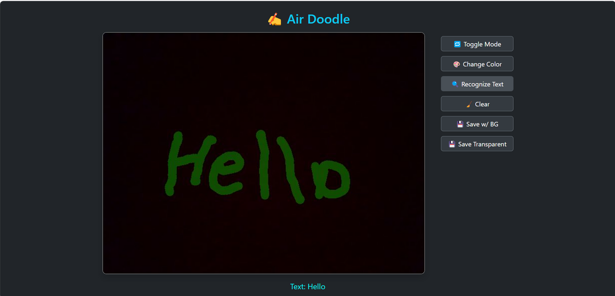

Overview
Air Doodle is a gesture-based system that allows users to write and draw in midair using hand movements, eliminating the need for physical tools. The system employs computer vision and machine learning to track hand gestures through a webcam, mapping motion paths onto a digital canvas. It enhances human-computer interaction by providing a contactless, intuitive, and interactive experience, useful in fields like education, creative design, and accessibility.

Slide 3
Key Features
Gesture-Based Drawing: Enables users to create digital drawings and text using hand movements.
Real-Time Hand Tracking: Uses hand landmark detection to map finger motions accurately.
Text Extraction: Extracts text from the doodle using OCR.
Object Detection: Extracts and recognizes objects from the doodle.
Touchless Interaction: Eliminates the need for physical input devices, enhancing accessibility.
Applications: Useful in virtual classrooms, digital art tools, smart environments, and assistive technology.
Future Scope: Can be expanded to support multi-hand input, gesture-based commands, and advanced shape recognition.

Slide 4
Technologies used
OpenCV – For real-time hand tracking and gesture detection.
MediaPipe – Accurate hand landmark detection for air writing.
Google Cloud Vision API – Extracts text from doodles using OCR.
CNN Model – Detects and classifies doodled objects.
YOLO Model – Fast and accurate object detection for recognizing gestures and hand positions.
NumPy & Matplotlib – For handling numerical operations and visualizes traced movements.
Flask / FastAPI – Backend API for processing and returning results.
JavaScript – Renders real-time doodles and recognized objects on UI.

Slide 5
Problem Statement
Traditional writing requires physical surfaces, limiting flexibility. This project enables air writing and doodling using hand gestures, eliminating physical contact. The challenge is to accurately track hand movements, recognize text and objects, and process them in real-time.
Hand tracking accuracy – Ensuring precise fingertip detection for smooth writing.
Real-time processing – Maintaining low latency for a seamless experience.
Character recognition – Converting freehand air-written text into machine-readable format.
Noise filtering – Reducing unintended strokes and motion blur.
Multi-modal recognition – Identifying both text and object sketches.

Slide 6
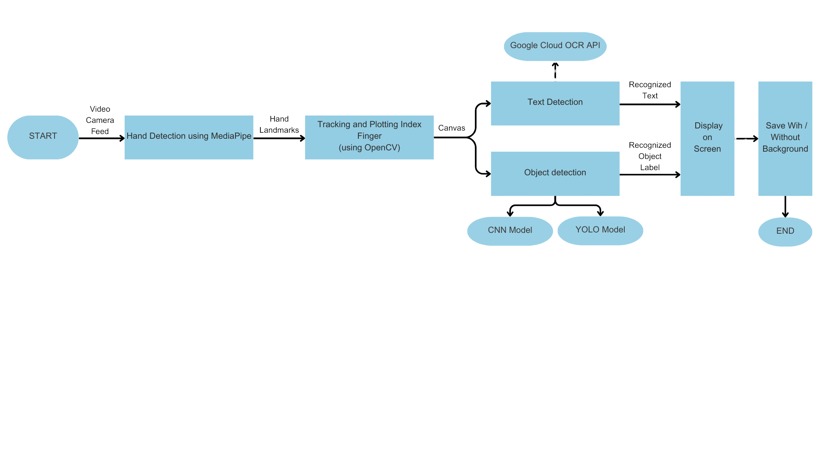
System Architecture

Slide 7
System Architecture
1. Input – Video Capturing
The system starts by capturing a video stream from a camera (real-time input).
This video serves as the foundation for detecting hand movements.
2. Hand Detection & Tracking (Processing Layer 1)
The MediaPipe library is used to detect the hand in the video feed.
Once the hand is detected, the index finger's movement is tracked using OpenCV to create a virtual writing path.

Slide 8
System Architecture
3. Text & Object Detection (Processing Layer 2)
The tracked finger movements generate a sequence of strokes, which are then processed as potential text or objects.
Two paths are followed here:
Text Detection: The stroke data is sent to the Google Cloud OCR API, which recognizes characters from the drawn shapes.
Object Detection: If an object is drawn instead of text, the system uses CNN or YOLO models to identify and classify it.

Slide 9
System Architecture
4. Output Processing & Display
Once the text is recognized, it is displayed on the screen in real-time.
The user has an option to save the recognized text with or without a background.
5. End Process
After recognition and saving, the system stops processing, completing the air writing operation.

Slide 10
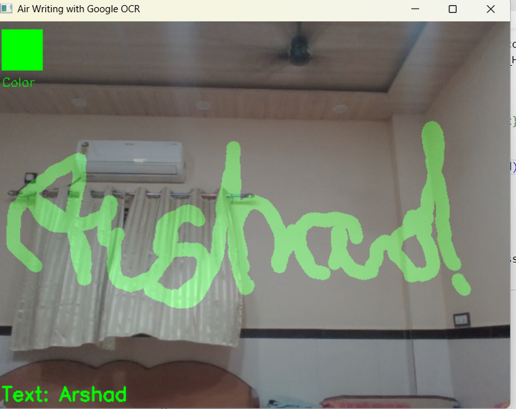
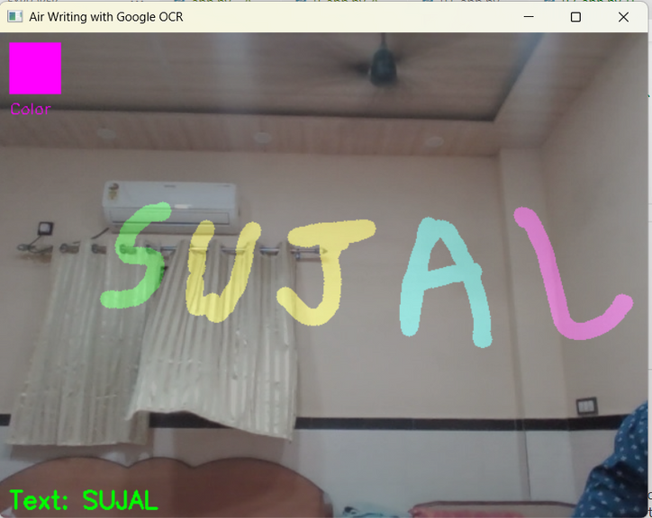
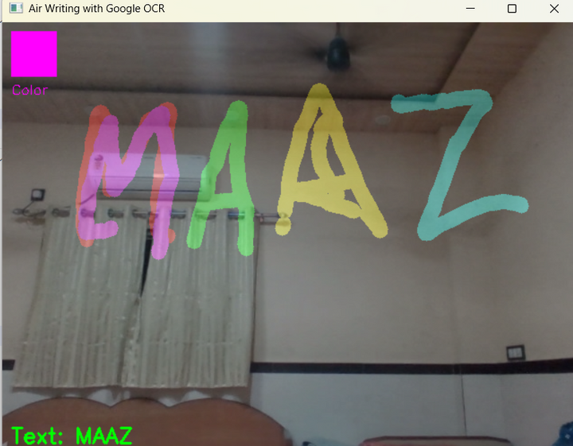
Text
Recognition
Results

Slide 11
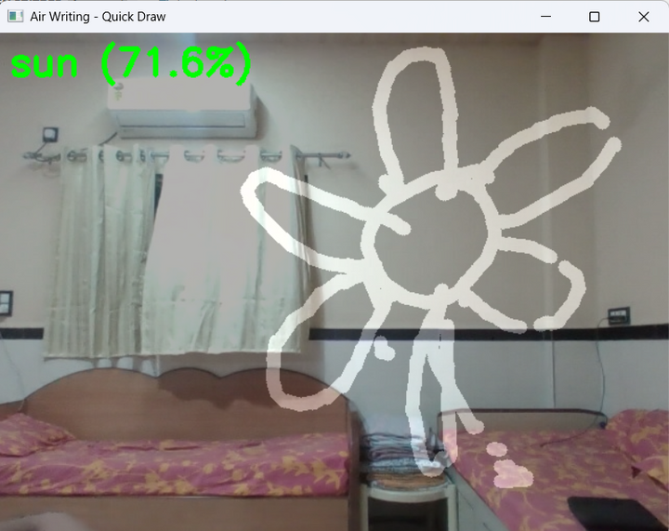
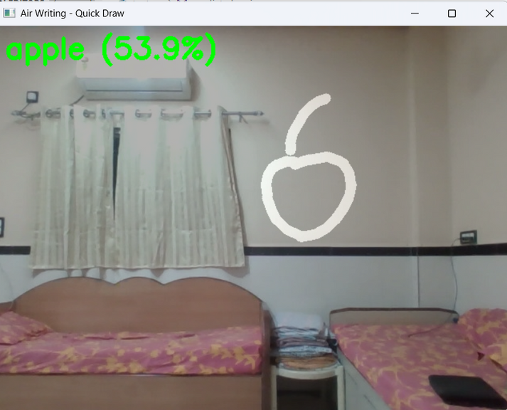
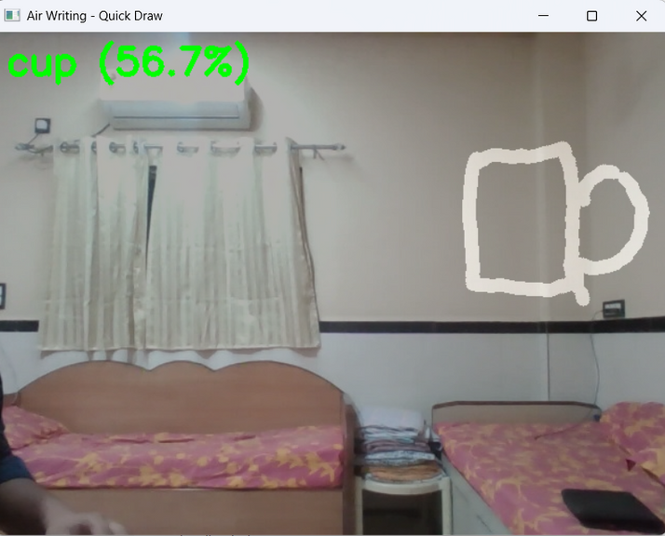
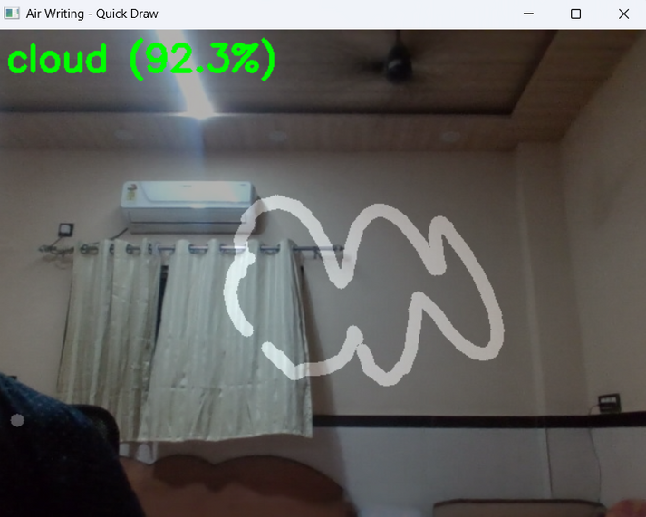
Object
Recognition
Results

Slide 12
Dataset
Data Collection:
Data was collected from Google’s Quick Draw! Dataset.
Dataset contains images of doodles along with labels.
Dataset Components:
Images: Images of the doodles of the objects along with their names.
Labels: Generated and derived from the images in the format required by YOLO model for training. It is in the format-
<class_id> <x_center> <y_center> <width> <height>
class_id → The index of the object class (starting from 0).
x_center → The normalized x-coordinate of the object's center (relative to image width).
y_center → The normalized y-coordinate of the object's center (relative to image height).

Slide 13
Dataset
width → The normalized width of the bounding box.
height → The normalized height of the bounding box.
Data Preprocessing
Frame Extraction: Convert videos into frames to analyze hand positions.
Normalization: Scale coordinates to maintain consistency across different devices.
Noise Reduction: Filter out accidental hand movements.
Augmentation: Vary hand speed, size, and background to improve model generalization.

Slide 14
Model Training
For our Air Writing project, we trained a YOLO model to recognize hand gestures and track writing movements in real time. The training process involved the following steps:
1. Dataset Preparation
Collected and annotated images containing hand gestures used for air writing.
Labels were formatted in YOLO’s required format (class_id x_center y_center width height).
Split the dataset into training, validation, and test sets.
2. Model Selection & Configuration
Used a pretrained YOLOv8 model as a base for transfer learning.
Adjusted the model’s configuration (img_size, batch_size, epochs, etc.).
Defined the data.yaml file, mapping class names and dataset paths.

Slide 15
Model Training
3. Model Training
Fine-tuned the YOLO model on our dataset using the Ultralytics YOLOv8 framework.
4. Key training parameters:
Pretrained weights: yolov8n.pt (YOLOv8 nano for efficiency).
Epochs: 50 (adjusted based on model performance).
Image size: 640x640.
Batch size: Tuned based on GPU memory constraints.
5. Model Evaluation & Optimization
After training, validated the model on the test dataset.
Metrics analyzed: mAP (mean Average Precision), precision, recall, and F1-score.
Adjusted hyperparameters and retrained to improve accuracy.

Slide 16
Applications
1. Virtual Classrooms / E-Learning
Teachers can draw diagrams or write equations mid-air during online lectures.
Helps in creating interactive, touchless whiteboards.
2. Contactless Control Panels
Useful in sterile or hazardous environments (like medical rooms or labs) where touching surfaces is risky.
Users can draw or gesture to trigger actions or commands.
3. Handwriting Recognition without Pen and Paper
Users can write characters in the air and have them digitized into text.
Useful in mobile computing, language input systems, and digital signatures.
4.Interactive Presentations
Supports gesture-based annotations during live presentations.

Slide 17
Conclusion and Future Scope
Air Doodle offers a novel and user-friendly approach to drawing and writing in midair using hand gestures. By integrating real-time hand tracking with a custom-trained YOLO and CNN model for object recognition, the system successfully bridges gesture-based input and intelligent visual understanding. This project demonstrates the potential of contactless interaction, making human-computer interfaces more natural, interactive, and accessible across various domains.
The project can be extended to support multi-hand gesture recognition and advanced air-writing features like real-time text conversion. With optimization, it can be integrated into mobile or AR/VR platforms for immersive experiences. Future improvements could also involve gesture-controlled system commands and cloud-based sharing to enable broader real-world applications.

Slide 18
Thank you

